Slide 1



Crafting & Compelling Website Analysis, Audit, and Recommendations for IBM
Presented by Kirubha Mahesan

Slide 2



WEBSITE ANALYSIS
IBM: A Global Leader in Technology and Innovation
IBM is a global technology and consulting company headquartered in Armonk, New York. Founded in 1911, IBM is one of the world's leading providers of IT products and services, ranging from cloud computing and artificial intelligence (AI) to software development, hardware, and consulting services. IBM has a long history of innovation and is renowned for its contributions to enterprise solutions that drive digital transformation for businesses worldwide.

Slide 3



WEBSITE ANALYSIS
IBM's Core Offerings
IBM Cloud: Scalable and secure cloud computing services for modern enterprises.
IBM Watson: AI-driven insights for better decision-making across industries.
IBM Security: Comprehensive cybersecurity solutions to protect digital assets.
IBM Quantum Computing: Pioneering quantum technology for research and innovation.
IBM Z: High-performance mainframe systems for mission-critical workloads.

Slide 4



WEBSITE ANALYSIS
IBM Website Platform Analysis
Platform: Custom-built using JavaScript, HTML5, CSS3, Node.js, and Java.
Frameworks: Utilizes Next.js for interactive features.
Performance Tools: Akamai, cloudfare, unpkg and cdnjs for content delivery and performance optimization

Slide 5


WEBSITE ANALYSIS
Responsive Design and Mobile Optimization
Tested Pages:
IBM Homepage
IBM Cloud
IBM Watson
IBM Security
IBM Quantum Computing
Findings:
Mobile-friendly with responsive layouts.
Room for improvement in page load speed and touch target sizes.

Slide 6

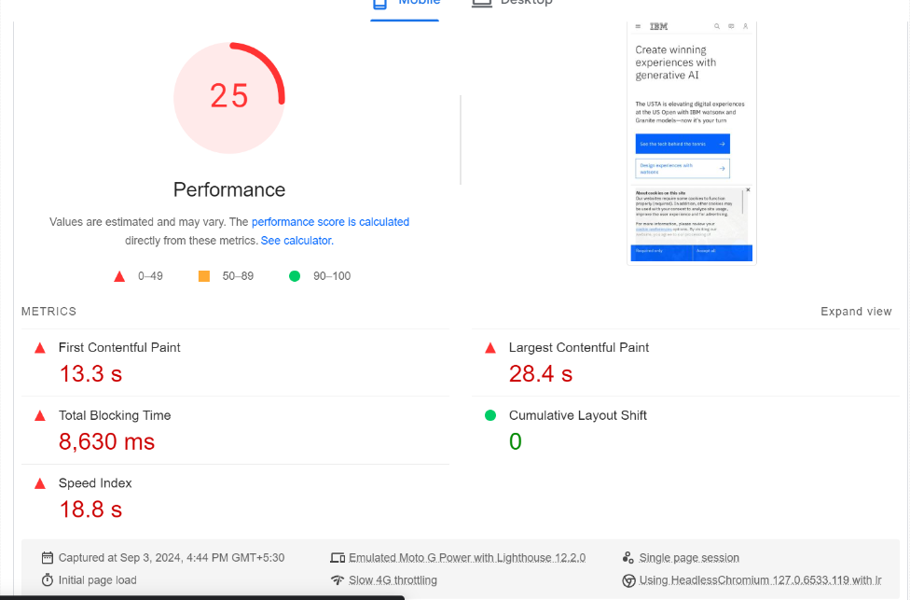
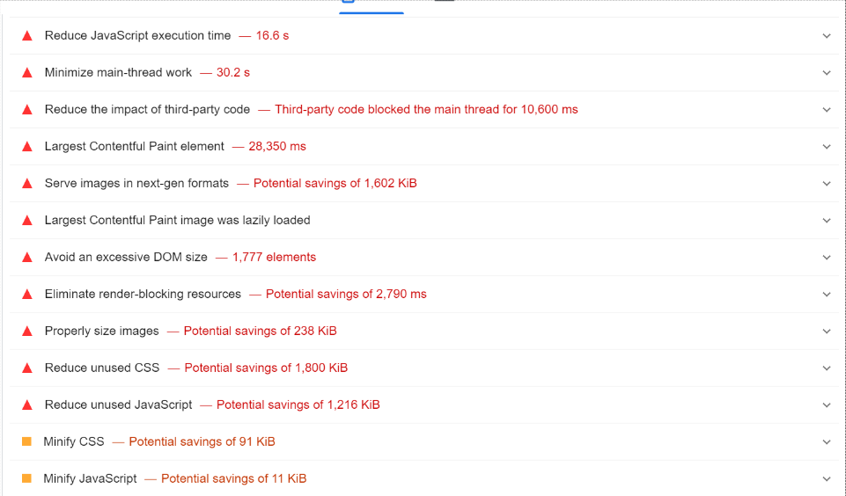
WEBSITE ANALYSIS
Webpage Analysis report

Slide 7




WEBSITE ANALYSIS
Identifying Areas for Improvement
Mistakes:
Cluttered Layout
Slow Loading Times
Inconsistent Design Elements
Overwhelming Amount of Text
Lack of Clear CTAs
Recommendations:
Simplify layout, optimize for speed, maintain design consistency, break up text, and enhance CTAs.

Slide 8


WEBSITE ANALYSIS
Best Practices for an Effective Website
Simplicity in Design
Fully Responsive Layout
Consistent Branding
Fast Load Times
Clear and Intuitive Navigation
Accessible Content for All Users
High-Quality Engaging Visuals
Strong and Visible CTAs
SEO-Friendly Structure
Regular Testing and Iteration

Slide 9



WEBSITE ANALYSIS
Summary and Next Steps
Summary: IBM’s website has strong foundations but can benefit from targeted improvements in design, UX, and performance.
Recommendations: Implement the suggested changes to enhance user experience, increase engagement, and improve overall performance.
Next Steps: Consider an in-depth audit and phased implementation of improvements.

Slide 10
WEBSITE ANALYSIS
Landing Page Design for IBM
01
02
03
Clean, Professional Layout
Compelling Hero Section
Value Proposition
04
05
06
Trust Signals
Content Sections
Lead Capture Form

Slide 11

WEBSITE ANALYSIS
Landing Page Design
Ihttps://kirubha394.wixsite.com/myibm
Click to view Landing page

Slide 12


THANK YOU
WEBSITE ANALYSIS

